Slide 1


TOP 10 TIPS
FOR A GOOD NIGHT'S SLEEP
Deep understand your body
Notes:
https://www.slideshare.net/DanaFarber/top-10-tips-for-getting-a-good-nights-sleep

Slide 2




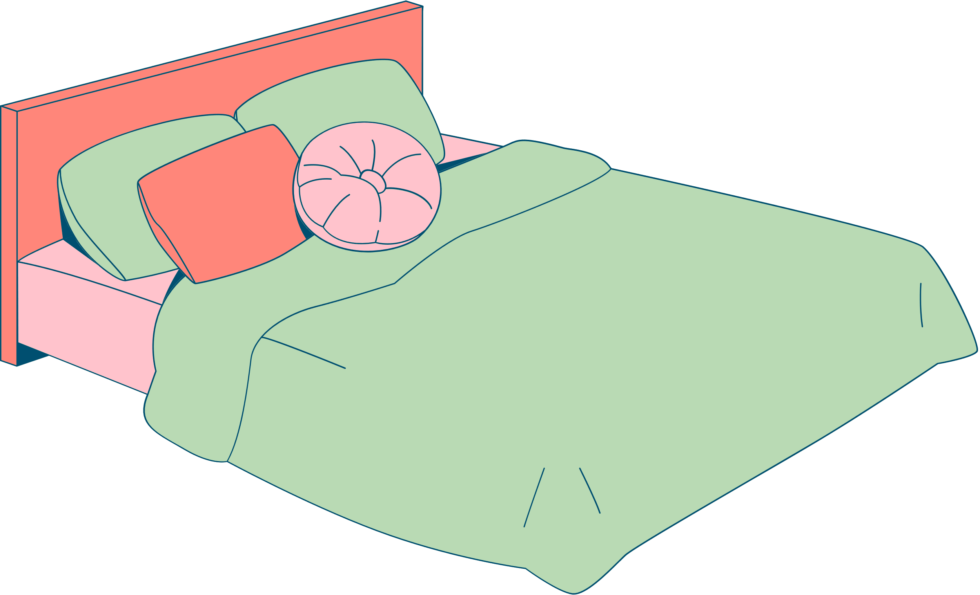


Try
using earplugs
or
wear sleep mask
free from
light & noises
Make sure
your beed room
is

Slide 3



Avoid
Say no to mobile phone
& social networks
Avoid screen
before bed time
Watching TV in the bed room
Remove electronics in the bed room

Slide 4



Avoid Alcohol
Especially 4-8 hours before bed

Slide 5



Avoid These Food
Pay attention to your eating routine.
Before the bed time
Heavy
spicy
sugary

Slide 6


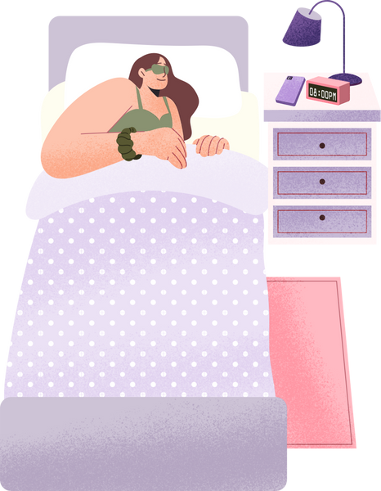
Only Use Your Bed For
Sleep
Sexual Activity

